Slide 1

A Comprehensive Framework for integrating AI with ZTA
CS 558 – Advanced Computer Security
Srushti Waichal
A20554818

Slide 2
Table of Contents
Project Overview
Background and Motivation
Methodology
Implementation Highlights
ZTA Framework
Integration with AI
Real-Time Anomaly Detection in Network Traffic
Model Monitoring and Improvement
Challenges and Future Work
Conclusion

Slide 3

Project Overview
Objective: Develop an AI-powered module for real-time threat detection within a Zero Trust Architecture (ZTA) framework
Key Components:
• Machine learning models for anomaly detection (Random Forest and Neural Network)
• Integration with Zero Trust Architecture principles
• Real-time analysis and alerting system
Project Scope: Focus on network traffic analysis and threat detection
Significance: Enhancing cybersecurity through AI-driven, continuous verification in ZTA

Slide 4

Background & Motivation
Zero Trust Architecture (ZTA):
A security model that assumes no user, device, or network should be automatically trusted • Definition: "Never trust, always verify" security model • Key principle: Continuous authentication and authorization
Evolving Cyber Threat Landscape: • Increasing sophistication of attacks • Limitations of traditional perimeter-based security
Role of AI in Modern Cybersecurity: • Ability to process vast amounts of data in real-time • Pattern recognition for identifying novel threats • Adaptability to evolving attack vectors
Motivation: • Need for dynamic, intelligent security solutions • Potential of AI to enhance ZTA implementation

Slide 5
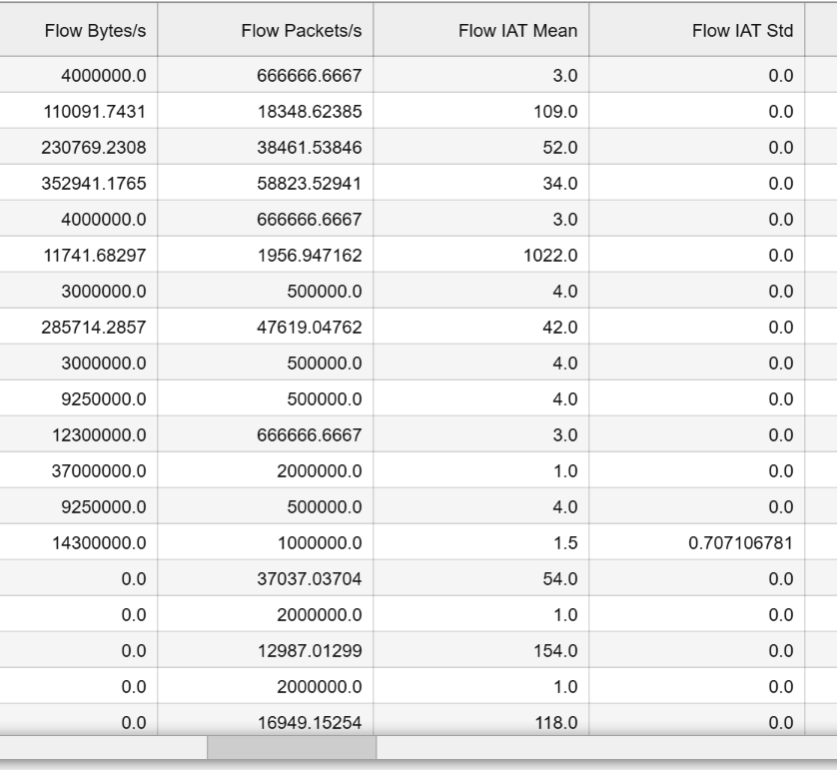
Methodology
Data Preparation
Load Dataset
Import the dataset using pandas to begin the preprocessing steps.
Encode Labels
Use LabelEncoder to encode categorical labels for supervised learning.
Convert to Numeric
Ensure all columns are in numeric format, handling any non-numeric data appropriately.
Handle Missing Values
Replace missing values with 0 after converting non-numeric data.
Replace Infinite Values
Replace infinite values with NaN and then fill with 0 for consistency.

Slide 6
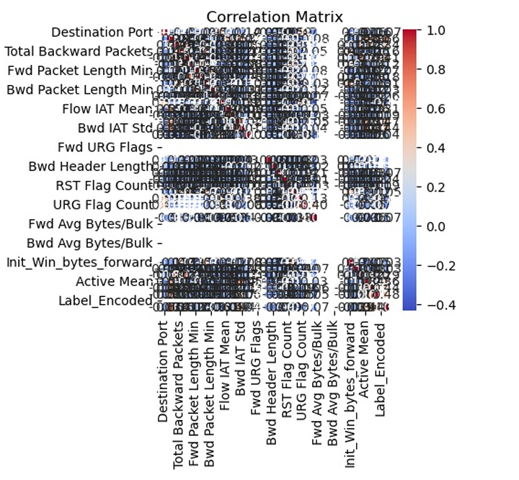
Feature Engineering
Data Exploration: • Examined the structure and content of the network traffic dataset • Identified key attributes related to network behavior and potential threats
Feature Selection: • Focused on relevant network traffic attributes: - 'Flow Duration' - 'Total Length of Fwd Packets' - 'Total Length of Bwd Packets’
Feature Scaling:
• Applied StandardScaler to normalize selected features • Ensured all features contribute equally to the model
Corelation Analysis
• Calculated and visualized the correlation matrix • Removed highly correlated features to reduce redundancy
Encoding Categorical Variables:
• Used LabelEncoder for the 'Label' column
• Transformed categorical data into numerical format
Random Forest Accuracy: 98.57%
Neural Network Accuracy: 97.14%

Slide 7
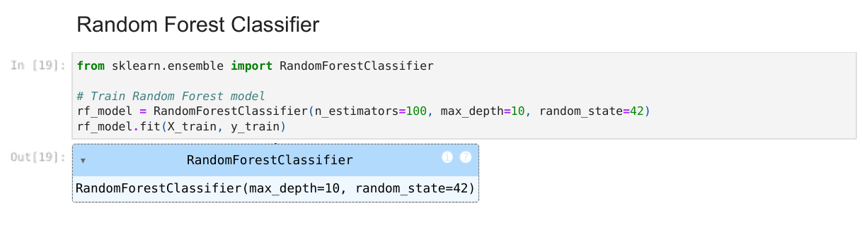
Model Development
Random Forest Classifier
• Effective for high-dimensional data • Handles non-linear relationships well • Provides feature importance rankings
Set parameters such as:
n_estimators=100: Built 100 decision trees.
max_depth=10: Limited the depth of each tree to prevent overfitting.
random_state=42: Ensured reproducibility of results.
• Accuracy: 98.57% • Precision: 94% • Recall: 94% • F1 Score: 0.94
These results indicate that the model is highly effective at detecting threats while maintaining a low false positive rate (high precision) and successfully identifying most threats (high recall).

Slide 8
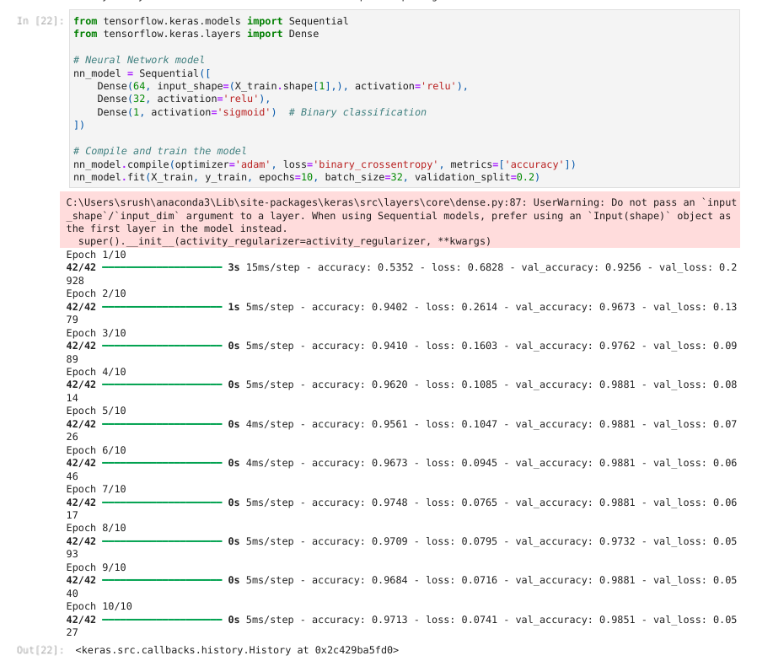
Neural Network
Why: • Can learn complex patterns in data • Adaptable to various types of input data • Potential for high accuracy with proper tuning
How: • Implemented using TensorFlow/Keras • Architecture:
Input -> 64 neurons -> 32 neurons -> 1 output neuron Activation functions: ReLU for hidden layers, Sigmoid for output
Results: • Accuracy: 97.14% • Precision: 93.18% • Recall: 82% • F1 Score: 0.8723
The Neural Network performed well but had slightly lower recall than the Random Forest model, meaning it missed more threats compared to Random Forest.

Slide 9

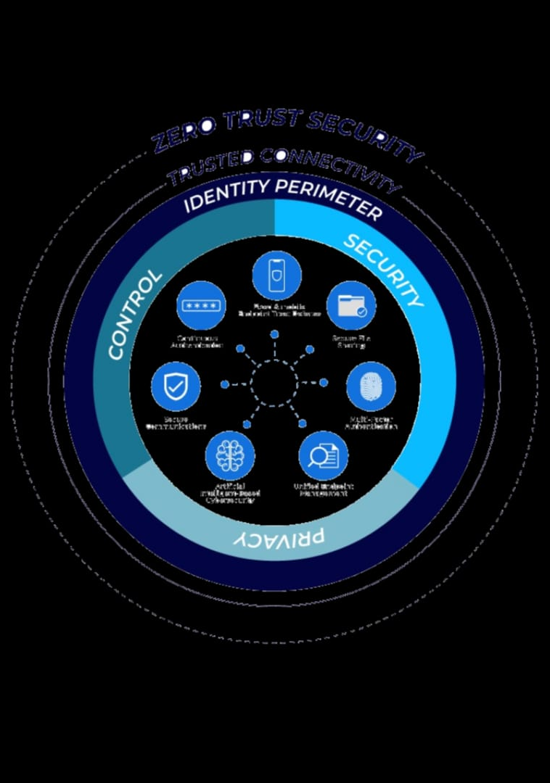
Zero Trust Architecture Framework
Why Zero Trust Architecture (ZTA)?
"Never Trust, Always Verify": ZTA is based on the principle that no user or device, whether inside or outside the network, should be trusted by default.
Granular Security: ZTA provides continuous verification of users, devices, and network traffic to ensure security at every access point.
Adaptive to Modern Threats: Traditional perimeter-based security models are no longer sufficient in today’s distributed environments. ZTA addresses this with a more dynamic and flexible approach to security.

Slide 10
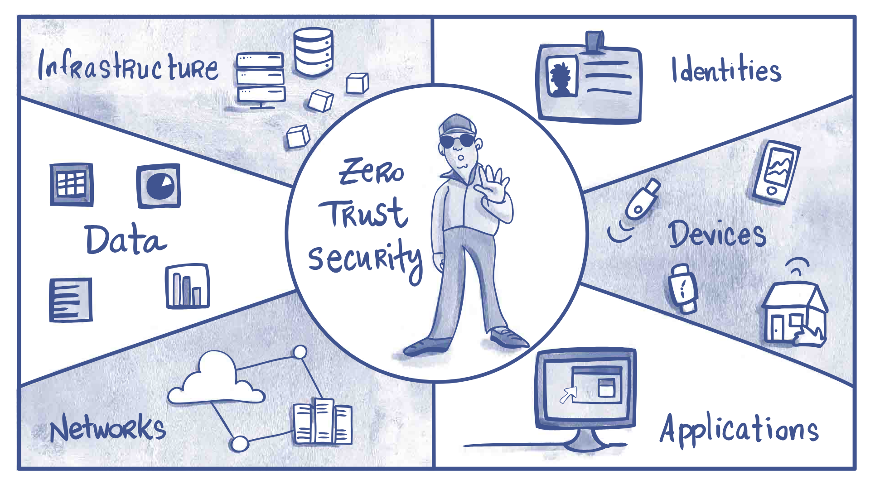
1. Continuous Verification Process:
Every access request is verified using AI-generated threat scores along with user credentials and device health.
The system continuously monitors network traffic and recalculates threat scores in real-time.
2. Threat Score Calculation Using AI Models:
Integrated Random Forest and Neural Network models to calculate a threat score for each network interaction.
The threat score is based on the probability that the activity is malicious.
3. Dynamic Access Control Decisions:
Based on the calculated threat score, the system makes real-time access control decisions.
If the threat score exceeds a certain threshold, access is denied; otherwise, access is granted.

Slide 11
Integrating with AI
1. Why Integrate AI with Zero Trust Architecture (ZTA)?
Dynamic and Adaptive Security: Traditional ZTA relies on static rules for access control. By integrating AI, the system becomes more adaptive, using real-time threat detection to make decisions.
Enhanced Threat Detection: AI models can analyze vast amounts of network traffic data and detect subtle patterns that may indicate malicious activity, which improves the overall security posture.
Continuous Verification: AI allows for continuous monitoring of users, devices, and network traffic, aligning with ZTA’s core principle of "never trust, always verify."
Automated Decision Making: AI-generated threat scores enable automated access control decisions, reducing the need for manual intervention.

Slide 12

2. How AI Was Integrated into the ZTA Framework
Threat Score Calculation Using AI Models:
Integrated machine learning models (Random Forest and Neural Network) to calculate a threat score for each network interaction.
The threat score is based on the probability that the activity is malicious.
Real-Time Access Control Decisions:
Based on the calculated threat score, the system makes real-time access control decisions.
If the threat score exceeds a certain threshold (e.g., 0.5), access is denied; otherwise, access is granted.
Continuous Monitoring and Real-Time Threat Detection:
Real-time data from network traffic is continuously fed into the AI models for analysis.
The system monitors each interaction and recalculates threat scores dynamically as new data comes in.

Slide 13
3. Results from AI-ZTA Integration
Improved Threat Detection
Accuracy:
The integration of AI models significantly enhanced the ability to detect potential threats in real-time.
Random Forest achieved an accuracy of 98.57%, while Neural Network achieved 97.14%, both providing strong performance in identifying anomalies.
Real-Time Decision Making:
The system was able to make real-time access decisions based on dynamic threat scores generated by the AI models.
Example output from real-time decision-making:
Threat Score: 0.0446, Decision: Access Granted to employee
Threat Score: 0.7584, Decision: Access Denied: High Risk Detected
Reduced False Positives/Negatives:
The use of machine learning models helped reduce false positives (incorrectly flagging normal traffic as malicious) and false negatives (missing actual threats).
Regular performance audits ensured that any misclassifications were identified and addressed through model retraining.
Scalability for Future Expansion:
The modular design of the ZTA framework allows for future integration with additional security components such as identity management systems or device trust mechanisms.
The system can scale to handle larger volumes of network traffic without compromising performance.

Slide 14

Real-Time Anomaly Detection in Network Traffic
Immediate Threat Response: Real-time detection allows for immediate identification and response to potential security threats, minimizing damage.
Continuous Monitoring: In modern networks, threats evolve rapidly. Continuous monitoring ensures that anomalies are detected as soon as they occur.
Proactive Security: Rather than waiting for post-incident analysis, real-time detection enables proactive defense mechanisms to prevent breaches before they escalate.

Slide 15
Results from Real-Time Anomaly Detection
a) Immediate Threat Identification:
The system successfully flagged potential threats as soon as they were detected in the simulated network traffic stream.
Example Output:
Normal Traffic Detected with Threat Score: 0.0665 Alert! Potential Threat Detected with Threat Score: 0.7584
b) High Accuracy in Anomaly Detection:
The Random Forest model achieved high accuracy in detecting threats during real-time monitoring.
Performance Metrics (from previous evaluation):
Accuracy: 98.57%
Precision: 94%
Recall: 94%
c) Low Latency in Detection:
The system was designed to process each incoming packet within milliseconds, ensuring minimal delay between detection and alert generation.
d) Scalability for High-Traffic Networks:
The modular design allows the system to scale up and handle larger volumes of network traffic without compromising detection speed or accuracy.

Slide 16

Model Monitoring and Improvement
1. Why Monitor and Improve Models?
Dynamic Threat Landscape: Cyber threats evolve rapidly, requiring models to adapt continuously.
Performance Degradation: Over time, models may become less effective as new types of threats emerge or network behavior changes.
Continuous Feedback Loop: Monitoring model performance in real-time allows for immediate identification of issues like false positives or false negatives.
Improvement Through Retraining: Regular updates to the model with new data ensure that it remains accurate and relevant.

Slide 17
2. How Model Monitoring Was Implemented
a) Real-Time Monitoring with Logging:
Implemented a logging system to track model predictions and decisions during real-time threat detection.
Logged both normal traffic and threat alerts for further analysis.
b) Periodic Performance Auditing:
Implemented a function to audit model performance periodically by comparing predictions with actual labels.
This helps identify false positives (incorrectly flagged normal traffic) and false negatives (missed threats).
c) Retraining the Model with New Data:
As new data becomes available (e.g., new types of network traffic or threats), the model is periodically retrained to adapt to these changes.

Slide 18
Challenges & Future Work
a) Handling Imbalanced Data
Why: In network traffic, malicious activities are rare compared to normal traffic, leading to imbalanced datasets.
Impact: This imbalance can cause models to favor the majority class (normal traffic), leading to missed threats (false negatives).
How Addressed: Techniques like oversampling the minority class, under-sampling the majority class, and using algorithms like Isolation Forest were explored to balance the data.
b) Optimizing Real-Time Performance
Why: Real-time anomaly detection requires fast processing to ensure immediate threat detection and response.
Impact: High latency in model predictions could delay responses to potential threats, reducing the system's effectiveness.
How Addressed: Limited the depth of decision trees in Random Forest (max_depth=10) and optimized data pipelines to reduce latency.
c) Model Interpretability
Why: Complex models like Neural Networks can act as "black boxes," making it difficult to understand why certain predictions were made.
Impact: Lack of transparency can reduce trust in AI-driven security systems and complicate security audits.
How Addressed: Used Random Forest’s feature importance analysis to identify which features were most influential in detecting threats, providing more interpretability.
d) Integration with Existing Security Infrastructure
Why: Integrating AI-based threat detection into existing Zero Trust Architecture (ZTA) frameworks can be challenging due to compatibility issues with legacy systems.
Impact: This could slow down deployment or require significant modifications to existing infrastructure.
How Addressed: Designed the system with modularity in mind, allowing for easier integration with other ZTA components like identity management systems.

Slide 19
Future Work
a) Enhancing Scalability for Large-Scale Networks: Focus on scaling the system to handle larger datasets and higher traffic volumes using distributed machine learning and parallel processing.
b) Implementing Advanced Ensemble Methods: Explore advanced ensemble techniques (e.g., stacking, boosting) to combine multiple models for improved accuracy and robustness.
c) Developing a Comprehensive Testing Framework: Build a robust testing framework using simulated attack scenarios (e.g., DDoS, malware) and real-world datasets to stress-test the system.
d) Exploring Deep Learning Models for Complex Pattern Recognition: Investigate advanced deep learning models (e.g., LSTM, CNNs) for detecting complex patterns in network traffic data and improving accuracy.
e) Improving Model Interpretability with Explainable AI (XAI): Incorporate Explainable AI techniques to make model decisions more transparent and understandable, building trust in AI-driven security systems.
f) Integration with Other ZTA Components: Expand the system by integrating additional ZTA components such as identity verification, device health checks, and dynamic access control mechanisms.

Slide 20
Thank you
Srushti Waichal
swaichal@hawk.iit.edu
A20554818

